Slide 1
DisMod III
Integrated systems modeling for disease burden’s long tail
Abraham D. Flaxman
JSM Vancouver, 2010

Slide 2
Introduction
For Global Burden of Disease Study (GBD) :
Must estimate incidence and duration for more than 250 diseases (by Nov 2010)
Estimates based on review of all available data, developed by 44 expert groups
Need estimates for 21 world regions, for males and females, for 1990 and 2005 (and 2010)
How?

Slide 3

Introduction
For Global Burden of Disease Study (GBD) :
Must estimate incidence and duration for more than 250 diseases (by Nov 2010)
Estimates based on review of all available data, developed by 44 expert groups (these data are inconsistent)
Need estimates for 21 world regions, for males and females, for 1990 and 2005 (and 2010)
How?

Slide 4
DisMod III Methods Outline
Consistency of epidemiological parameters
Bayesian priors
Borrowing strength between regions
Web 2.0 interface
Example Application - Guillain-Barré syndrome

Slide 5
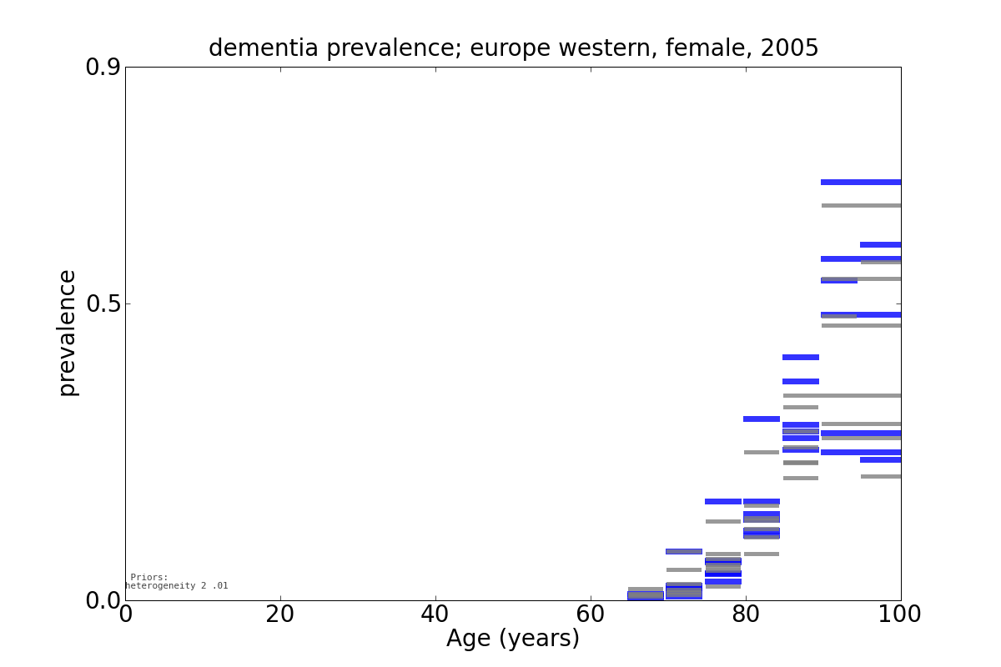
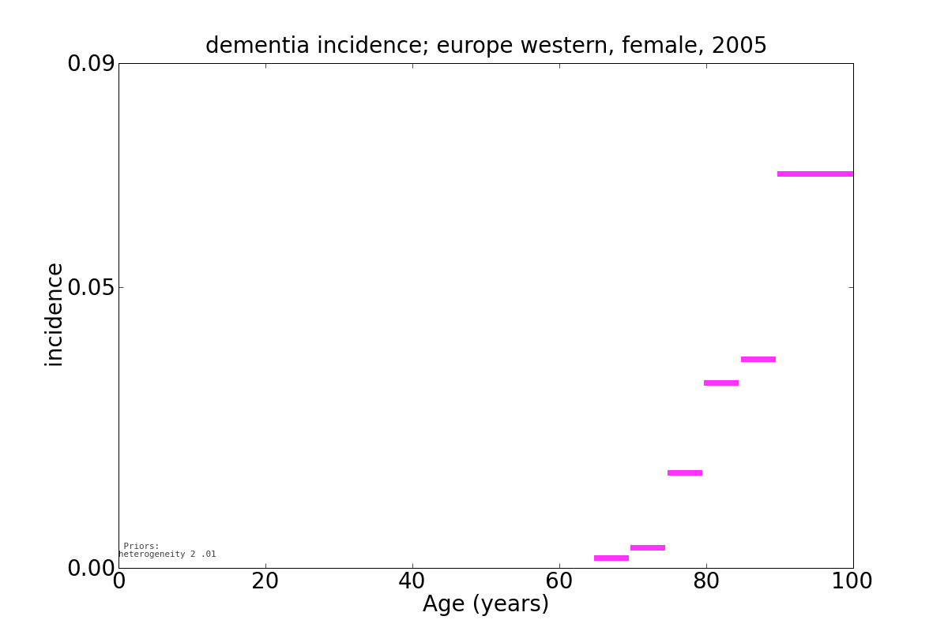
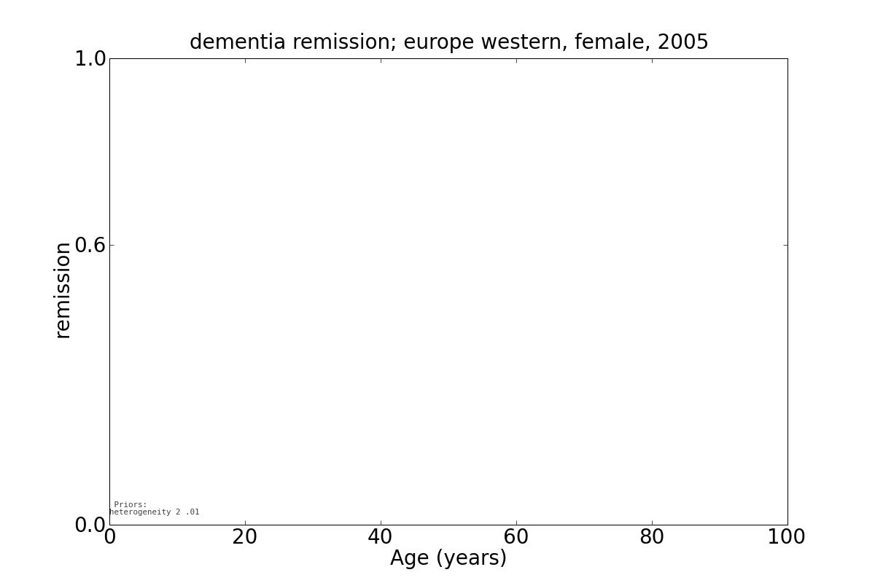
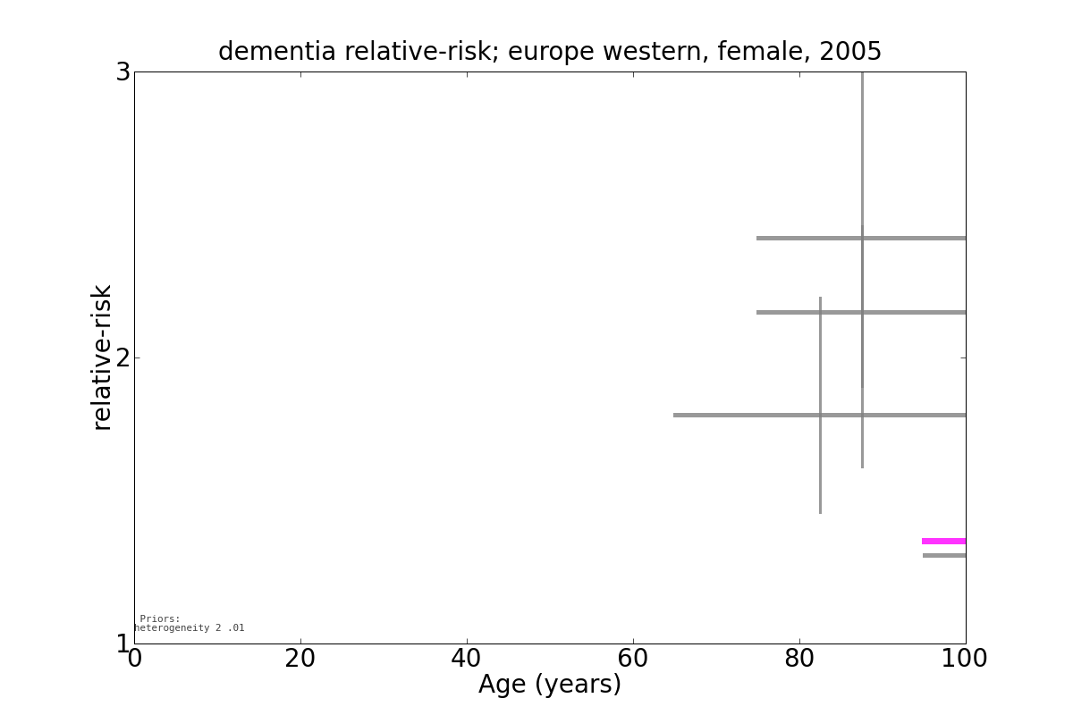
Some Example Data - Dementia

Slide 6
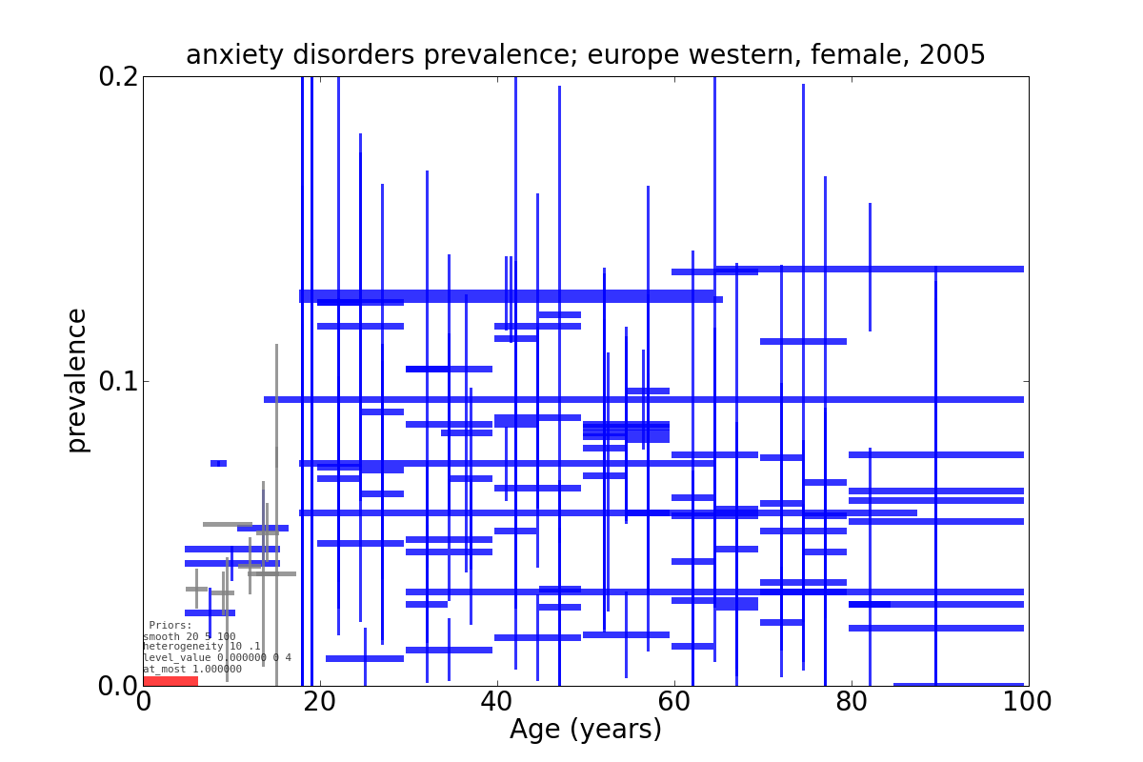
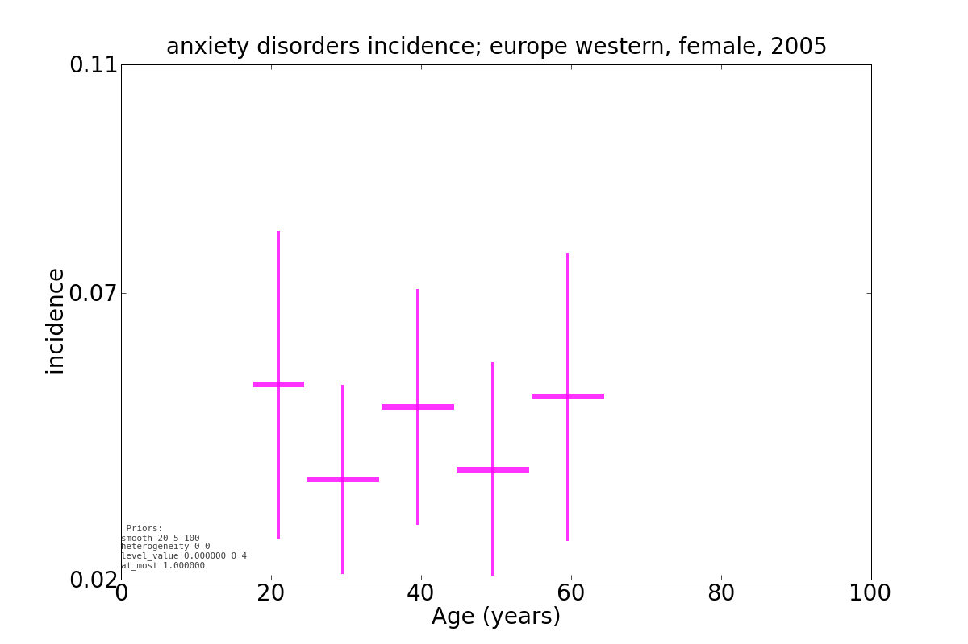
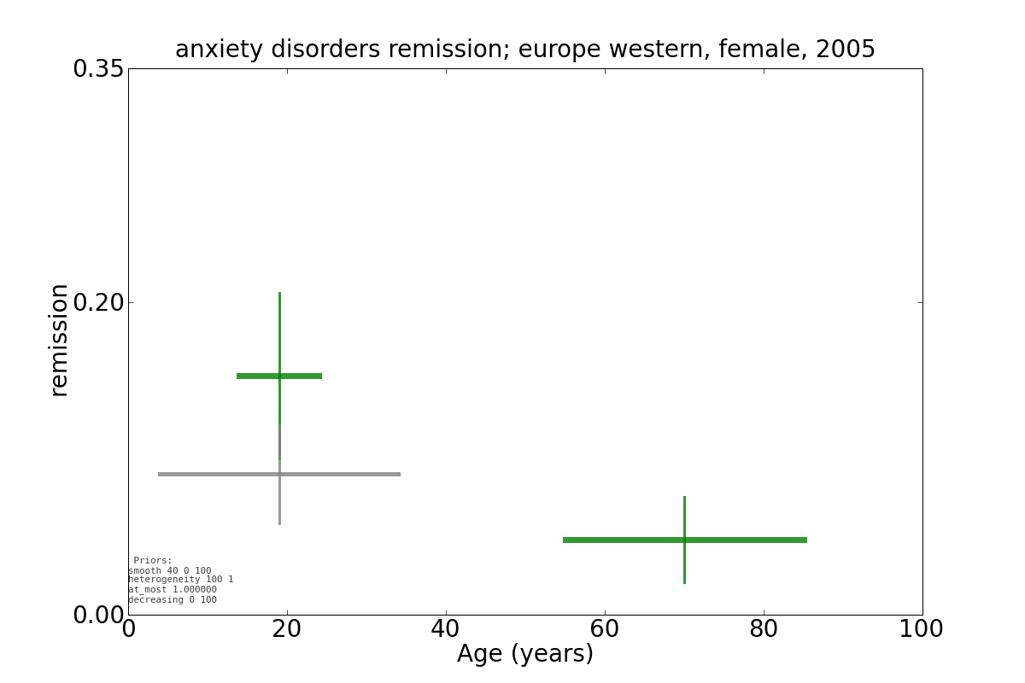
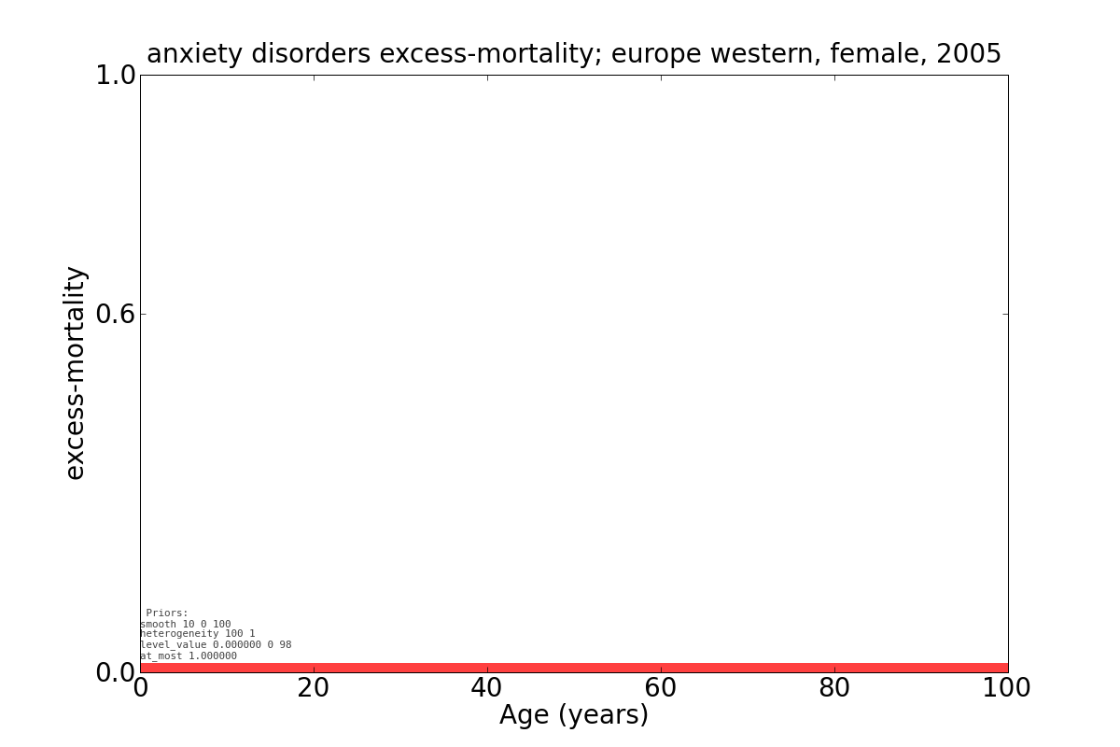
Some Example Data - Anxiety

Slide 7
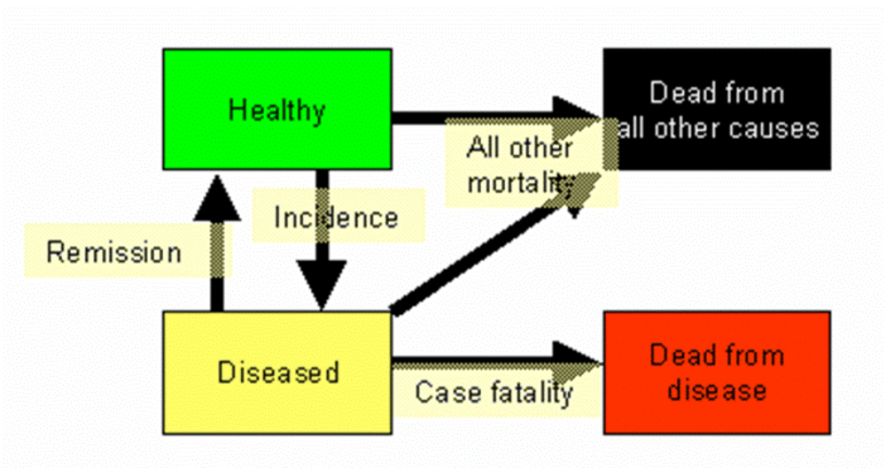
Compartmental Model for Consistency

Slide 8
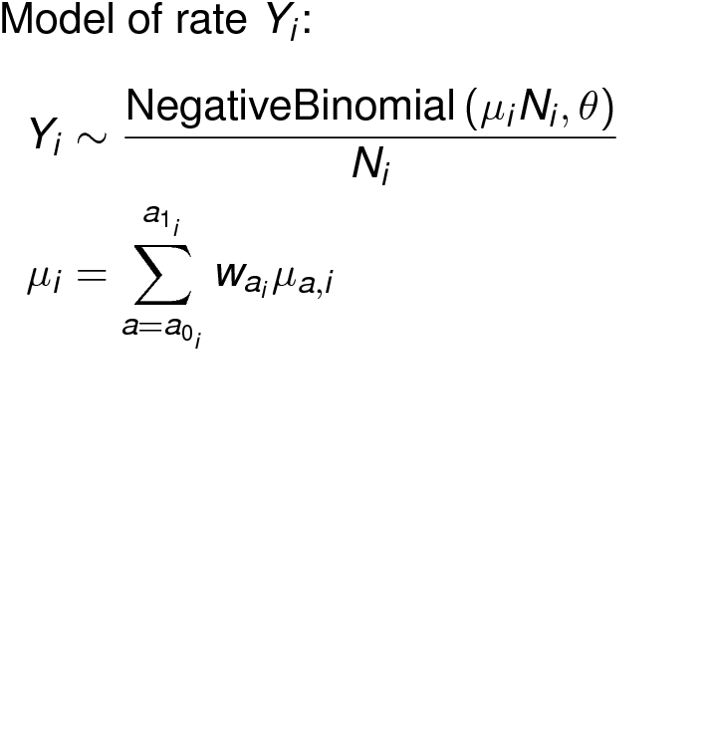
Bayesian Statistical Model

Slide 9
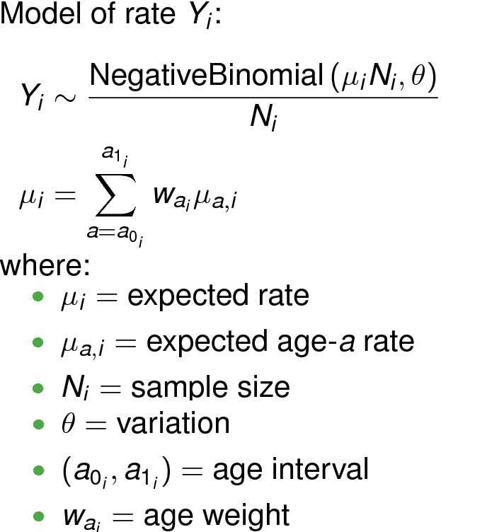
Bayesian Statistical Model

Slide 10


Bayesian Inference via MCMC
Computationally intensive, but possible
Allows expert priors

Slide 11
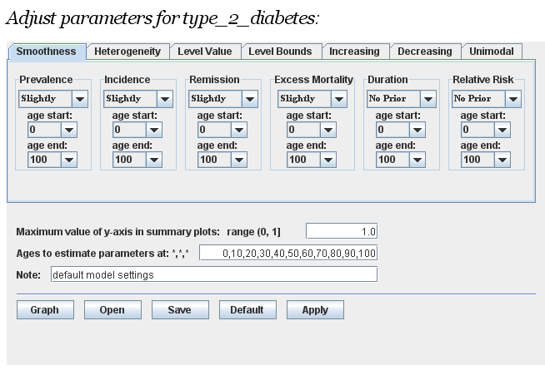
DisMod Expert Priors
Smoothing
Heterogeneity
Level bounds / values
Increasing, decreasing, unimodal

Slide 12
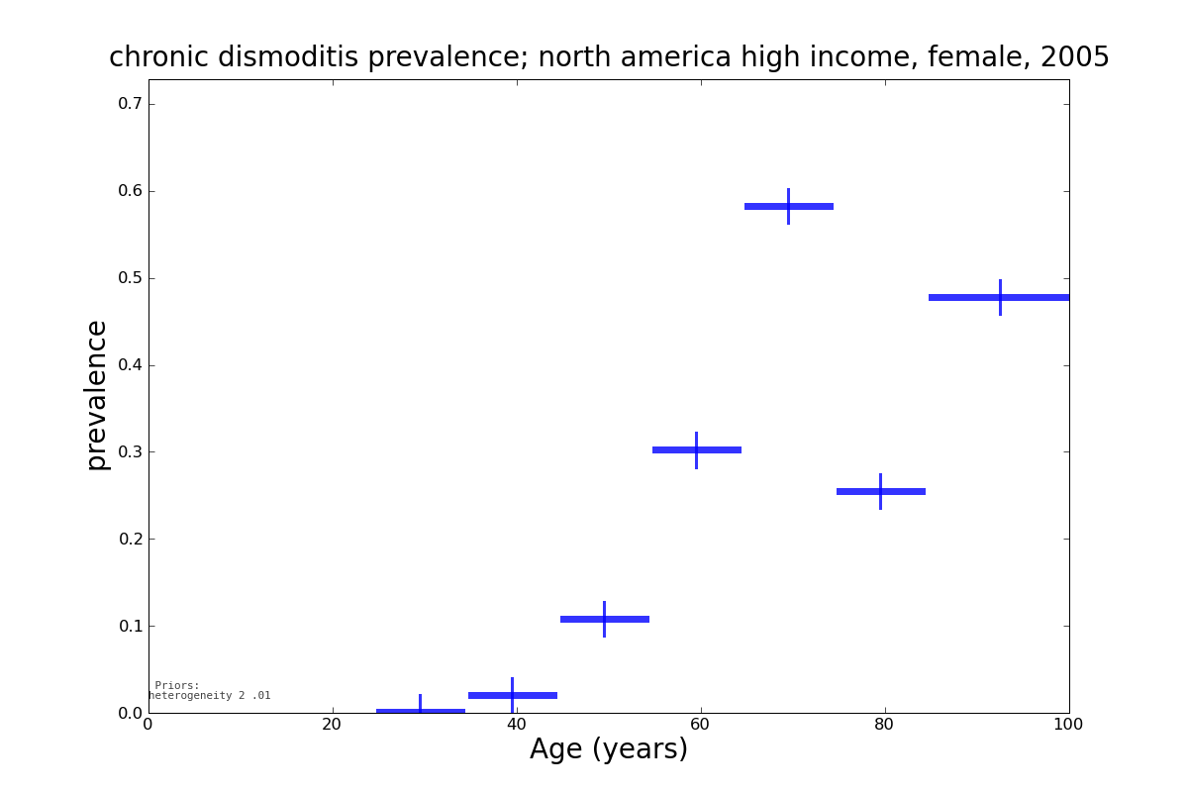
Expert Priors: Smoothing

Slide 13
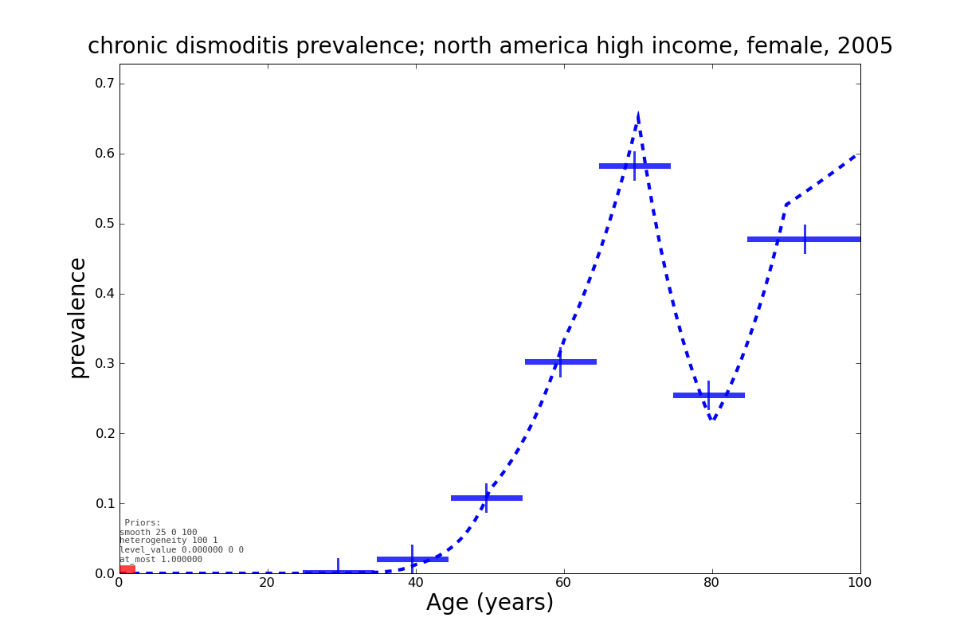
Expert Priors: Smoothing

Slide 14
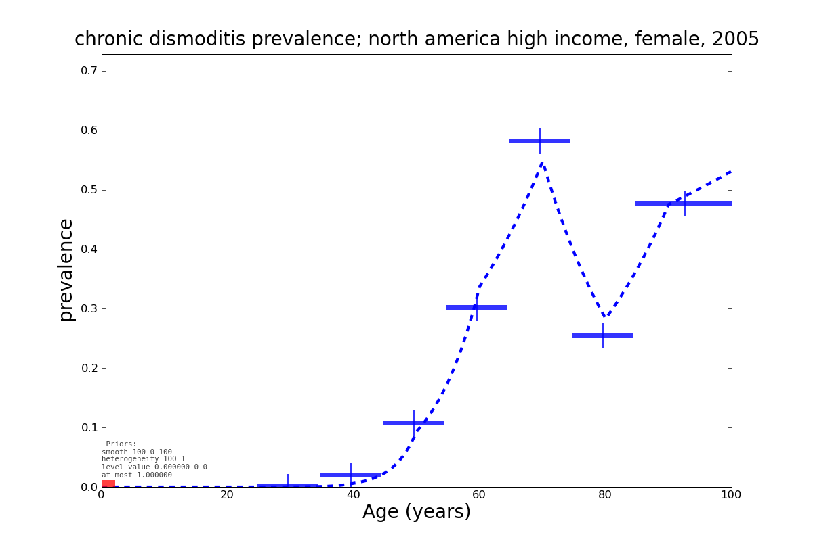
Expert Priors: Smoothing

Slide 15
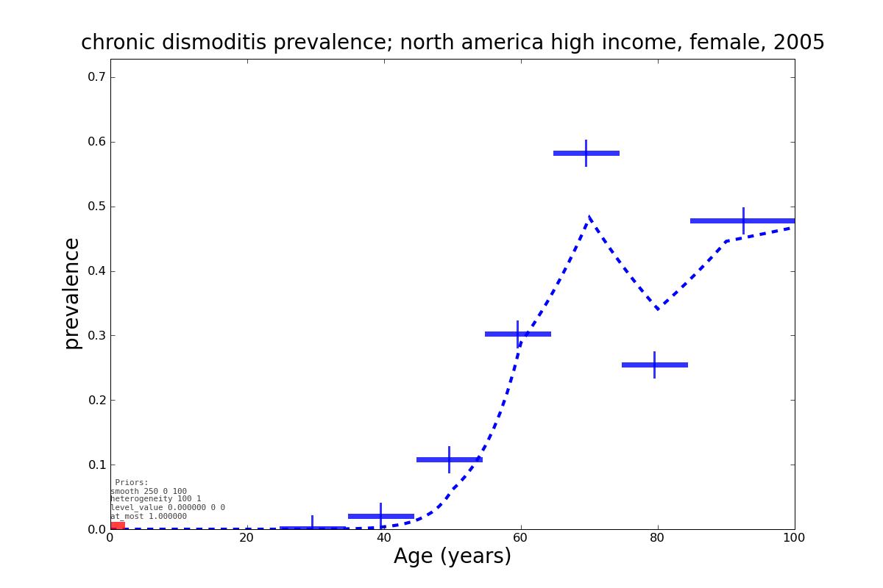
Expert Priors: Smoothing

Slide 16
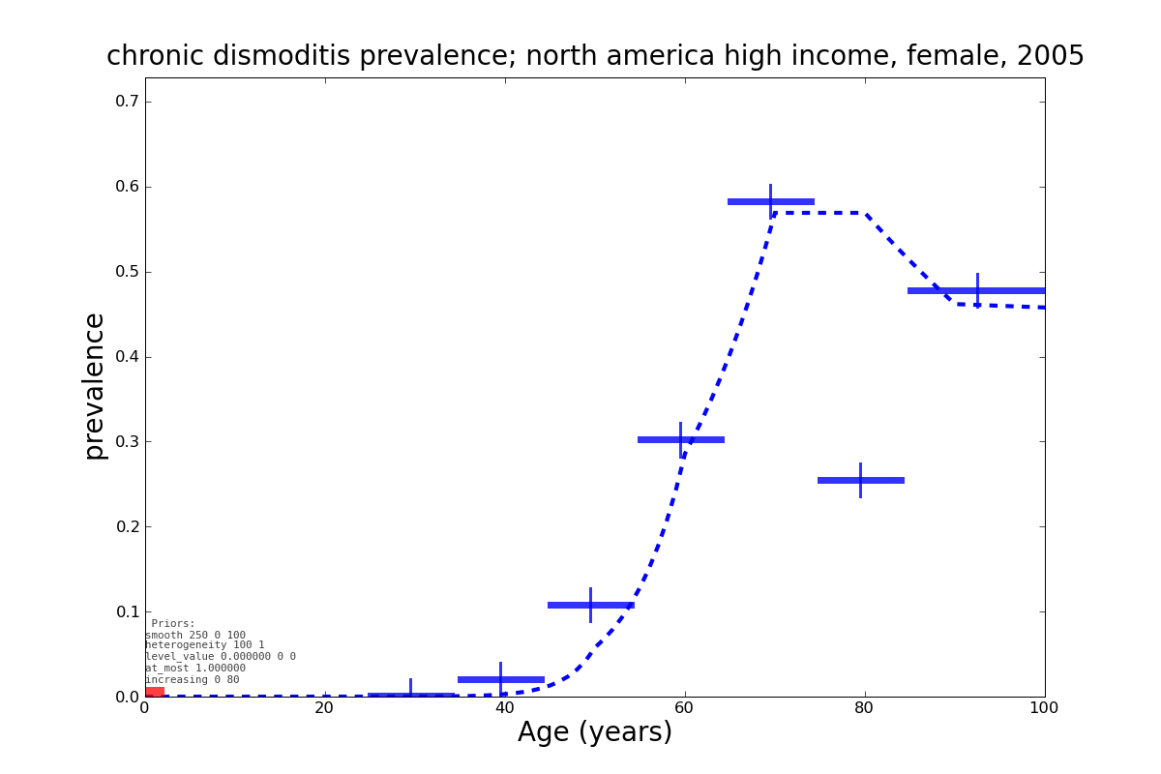
Expert Priors: Monotonicity

Slide 17
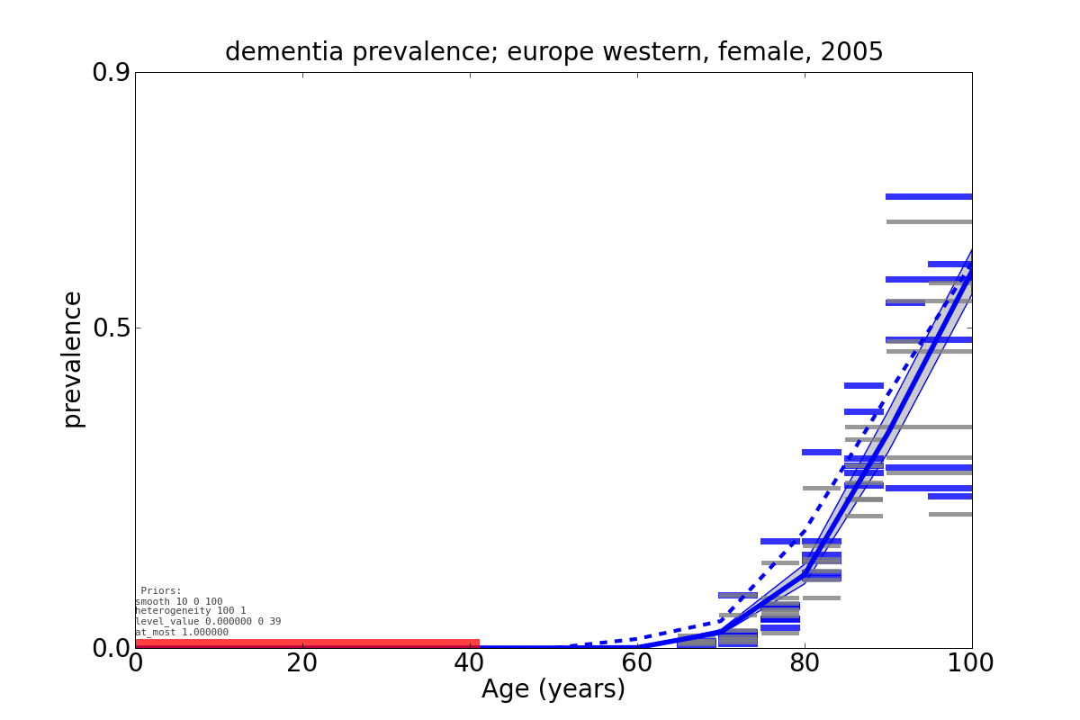
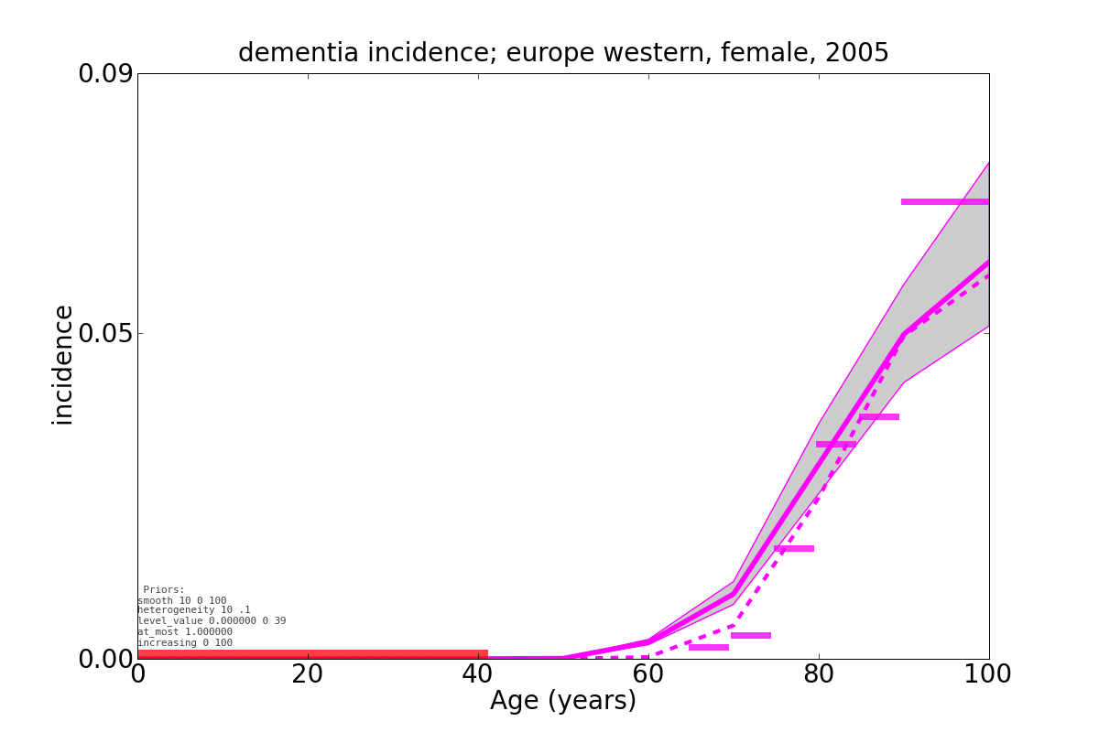
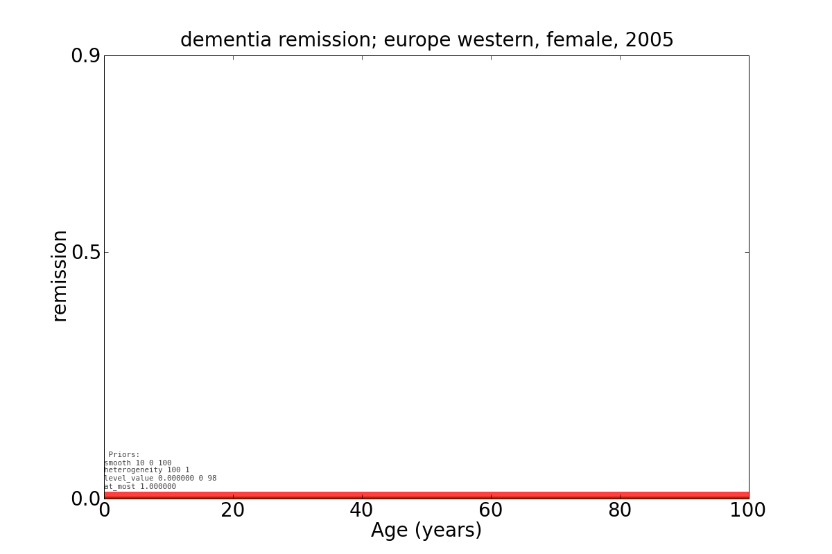
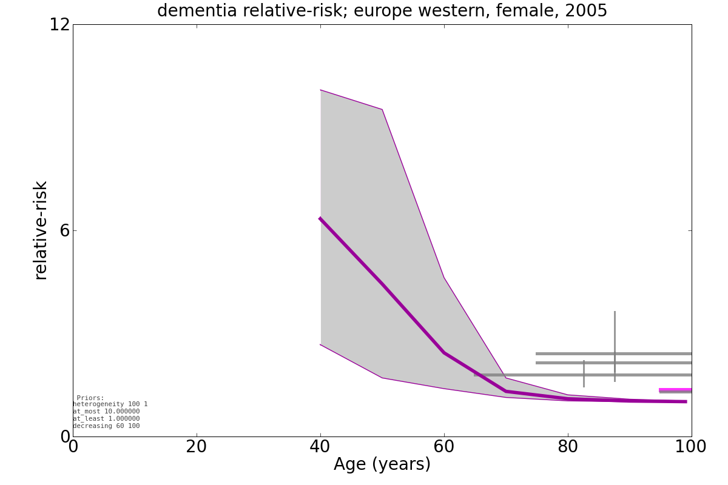
DisMod generates consistent estimates

Slide 18
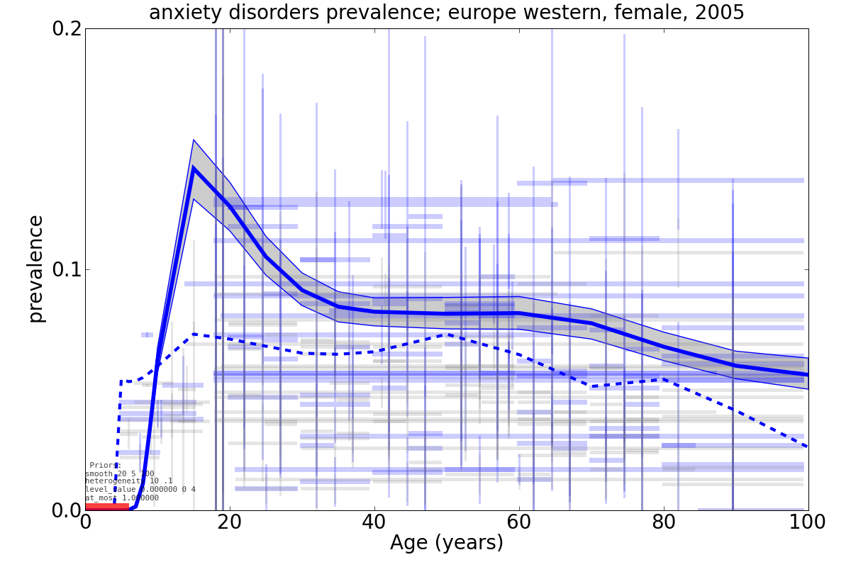
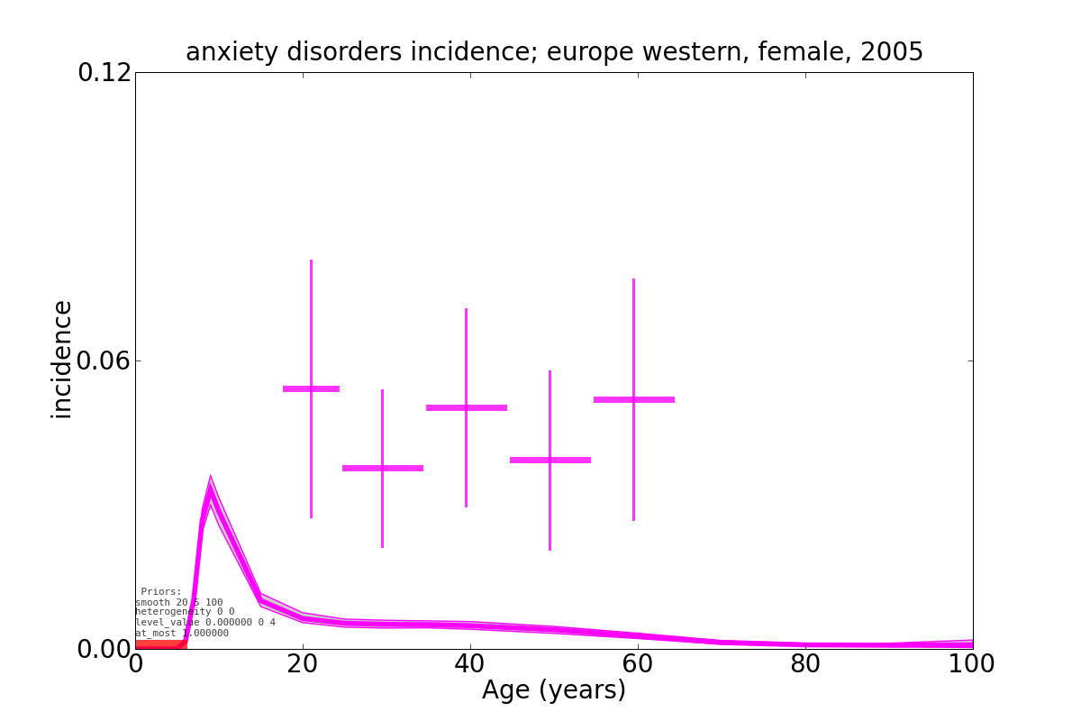
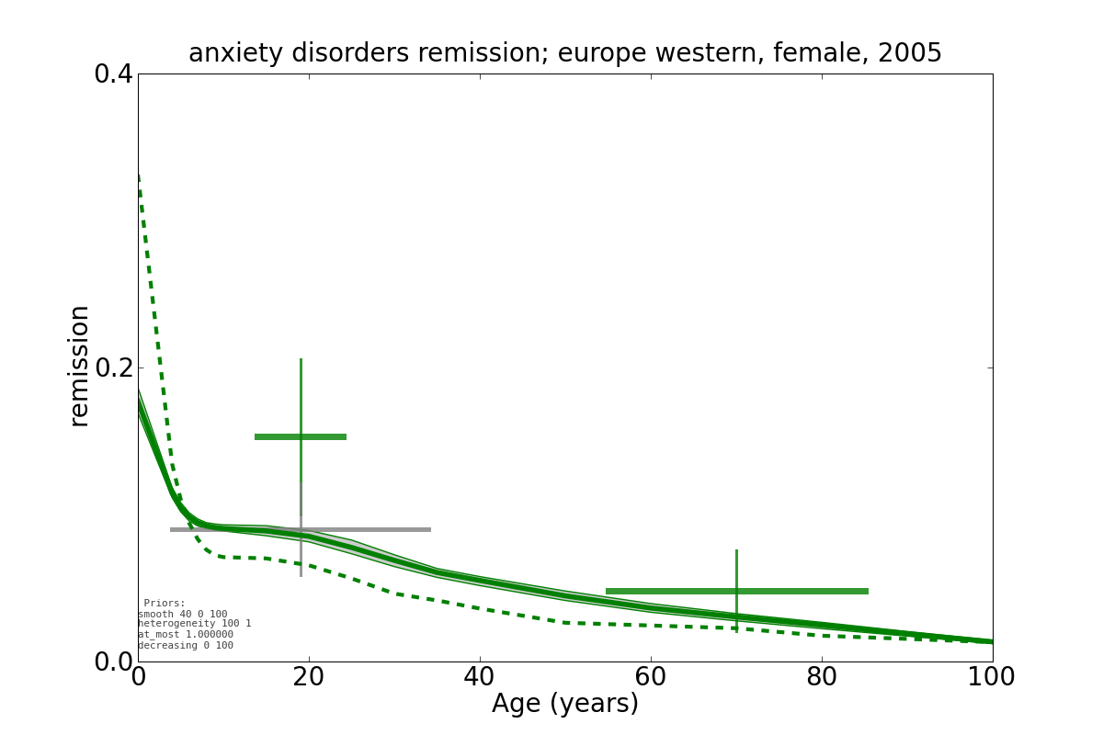
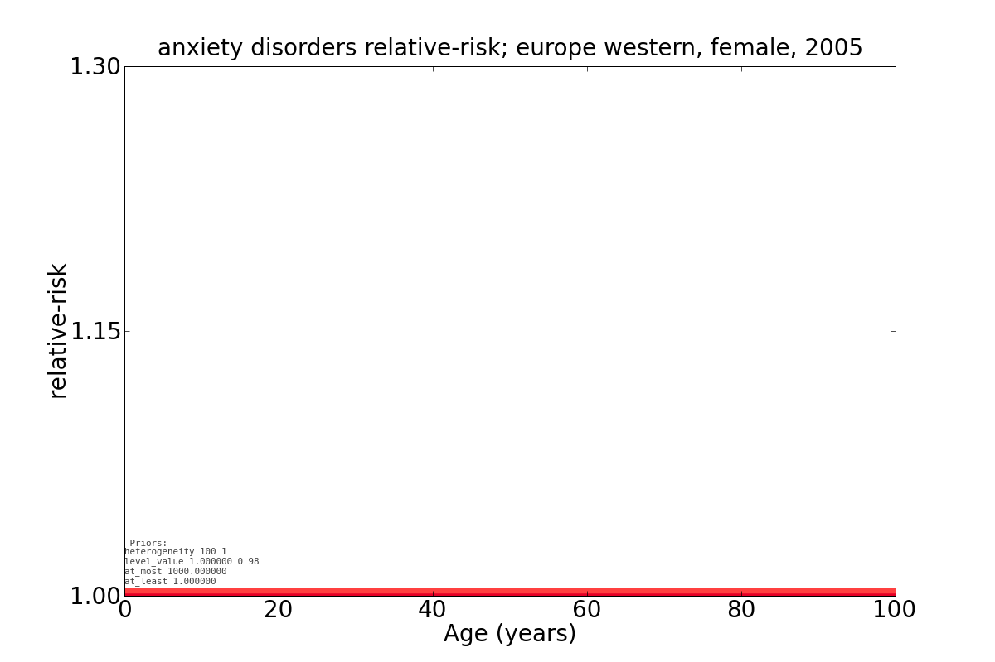
DisMod generates consistent estimates

Slide 19
Sparsity – Regions with little anxiety data
Region | prevalence | incidence | remission | mortality | total
Europe, Western | 223 | 14 | 5 | 0 | 242
Australasia | 69 | 0 | 0 | 0 | 69
Europe, Central | 65 | 0 | 0 | 0 | 65
North America, High Income | 60 | 0 | 1 | 0 | 61
Latin America, Southern | 8 | 0 | 0 | 0 | 8
Sub-Saharan Africa, East | 6 | 0 | 0 | 0 | 6
Caribbean | 1 | 0 | 0 | 0 | 1
Asia, Southeast | 1 | 0 | 0 | 0 | 1
Sub-Saharan Africa, Central | 0 | 0 | 0 | 0 | 0
Oceania | 0 | 0 | 0 | 0 | 0
Latin America, Andean | 0 | 0 | 0 | 0 | 0
Asia, Central | 0 | 0 | 0 | 0 | 0

Slide 20
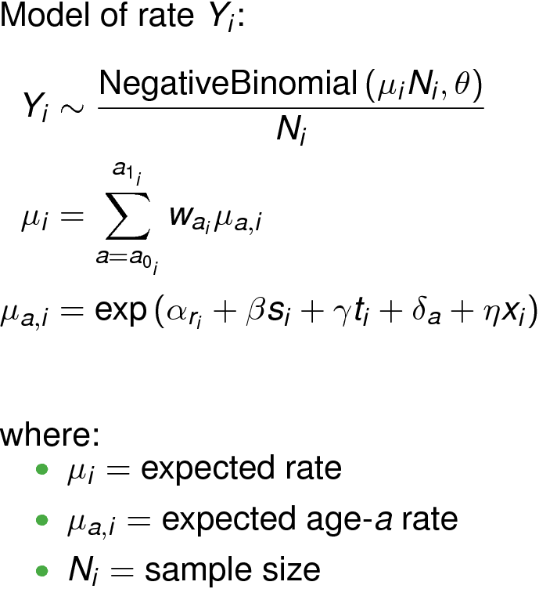
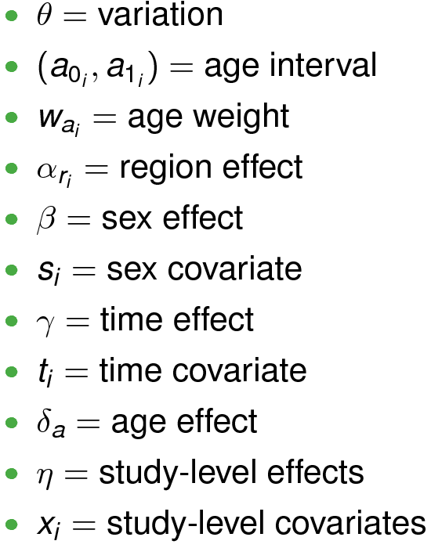
Statistical Model

Slide 21
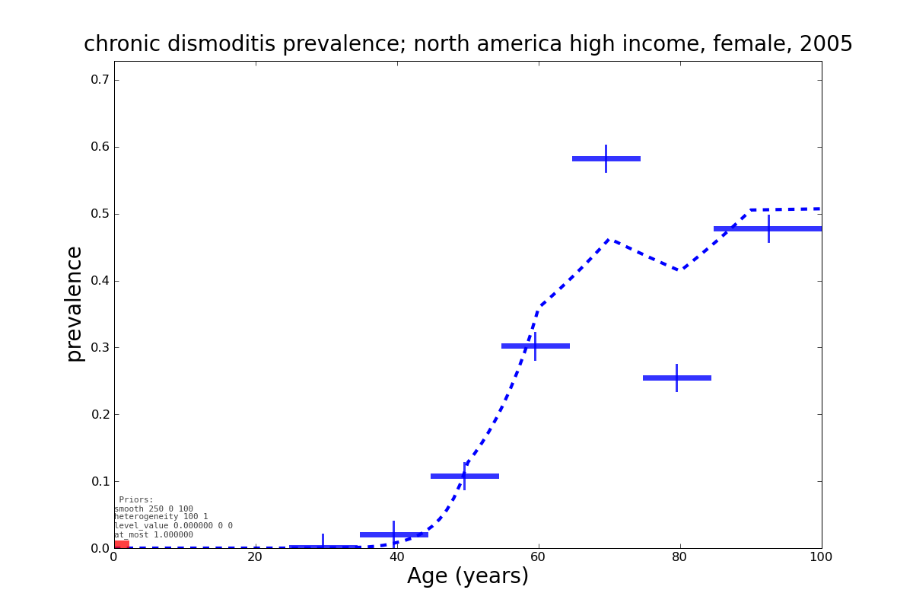
DisMod Empirical Priors

Slide 22
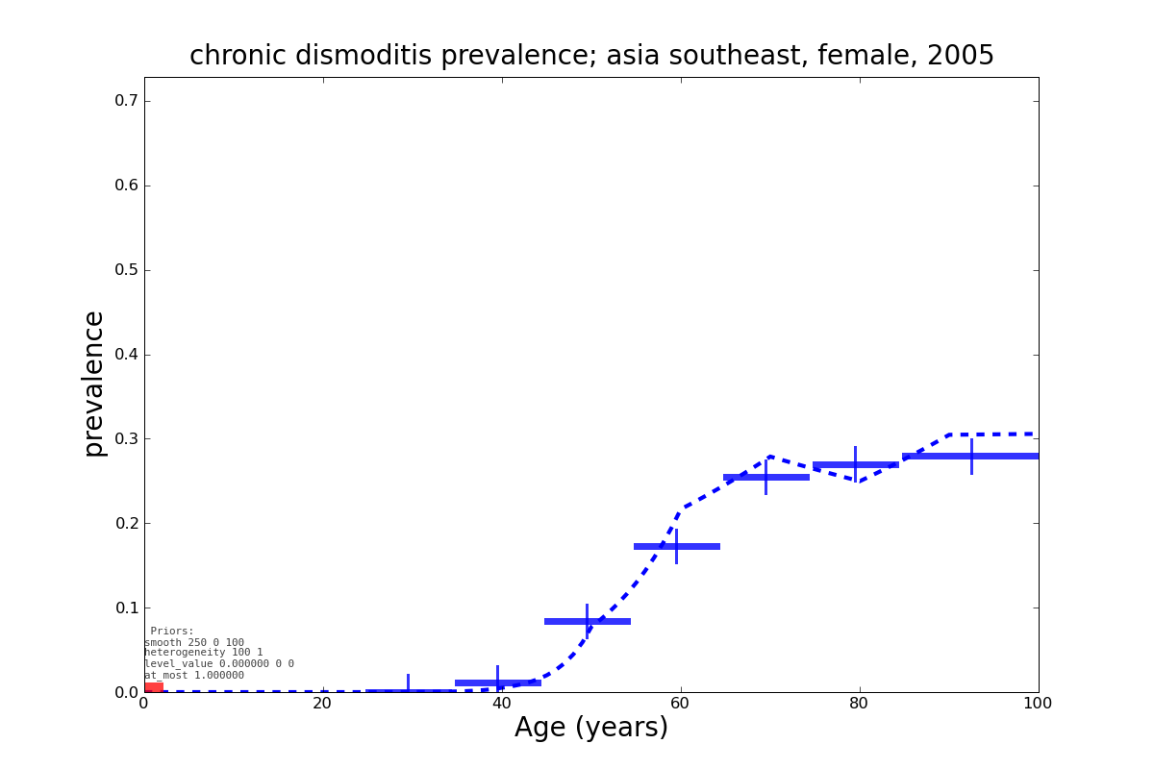
DisMod Empirical Priors

Slide 23
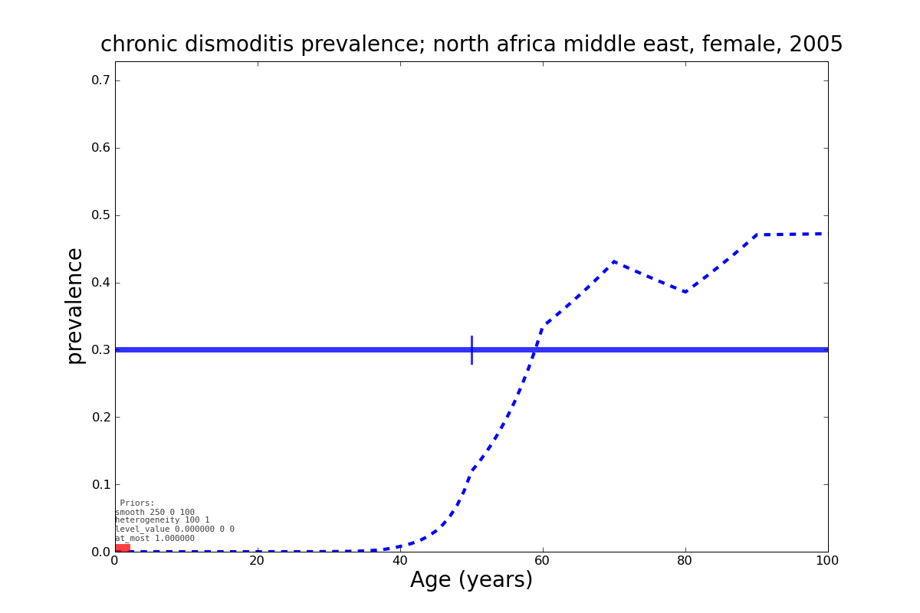
DisMod Empirical Priors

Slide 24
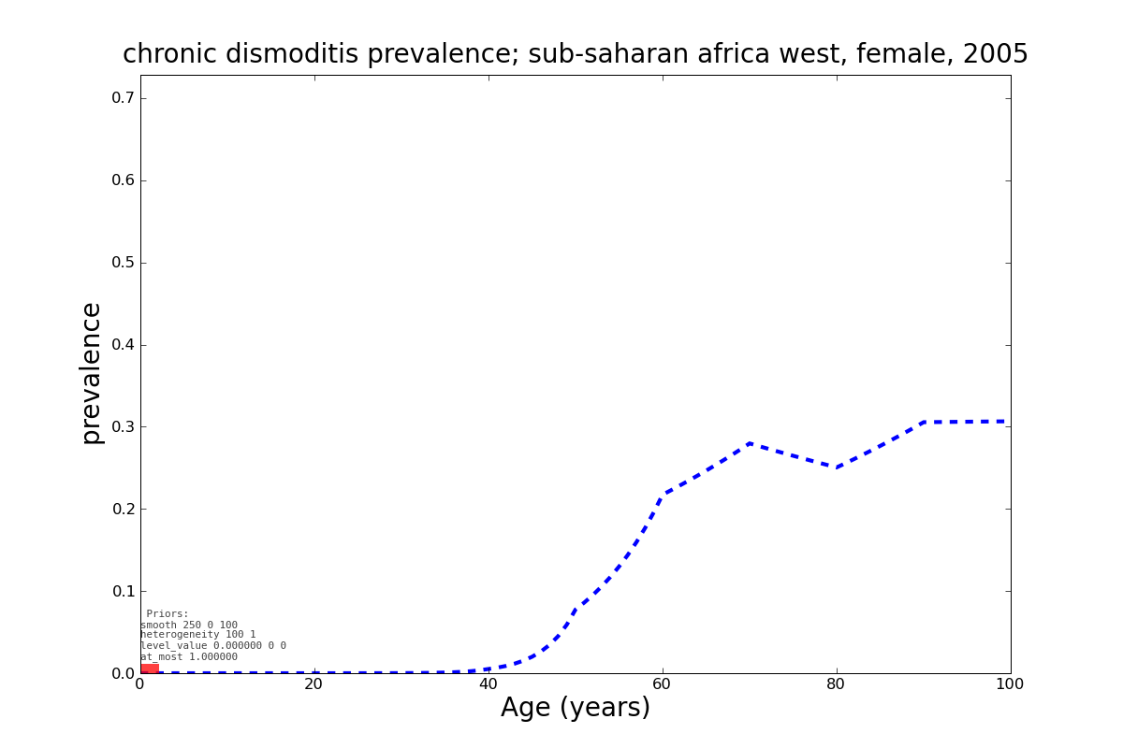
DisMod Empirical Priors

Slide 25

Burden of Disease Workflow
Clean Data
Check format
Check definitions with expert group
Clean as necessary
Load Data
Explore in STATA or other general programs
Explore in DisMod III
Analyze Data
Run Data
Adjust Expert Priors, adjust covariates
Discuss with Expert Groups
Repeat as necessary
Output Data
Graphs, tables, STATA
Check definitions in original data source
Incorporate additional data if necessary
Validation of results with other sources
Share results with expert groups

Slide 26
DisMod III
Web-based User Interface

Slide 27
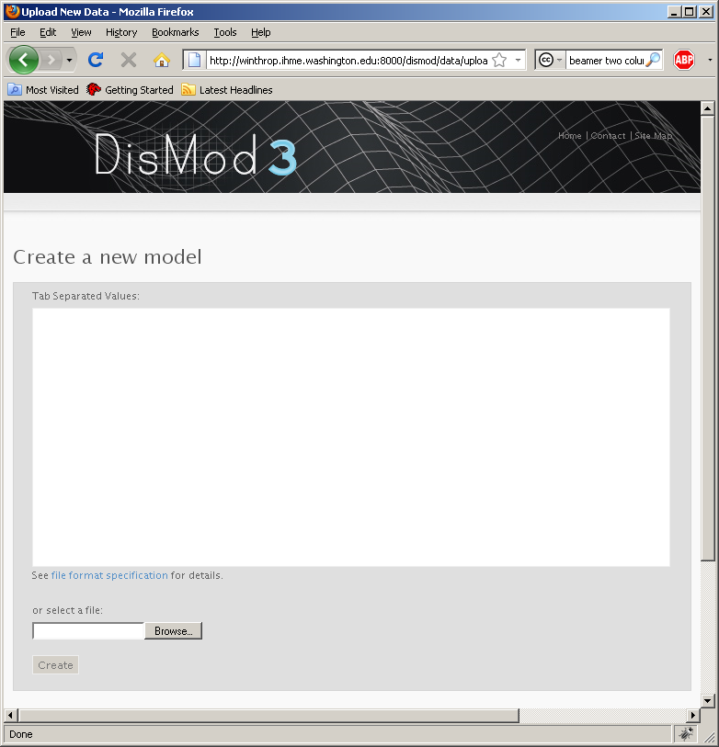
DisMod III

Slide 28
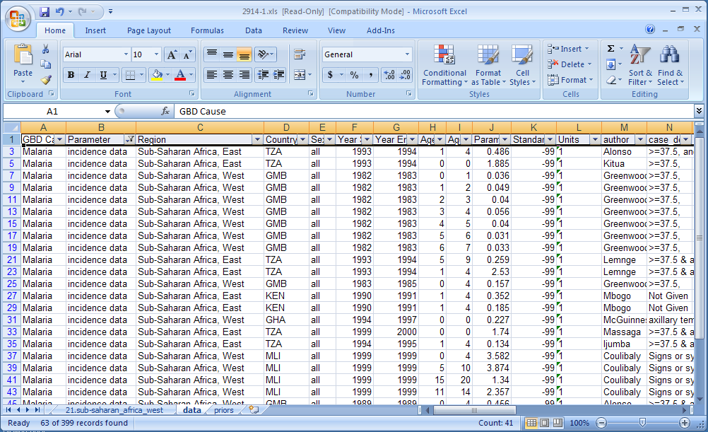
DisMod III

Slide 29
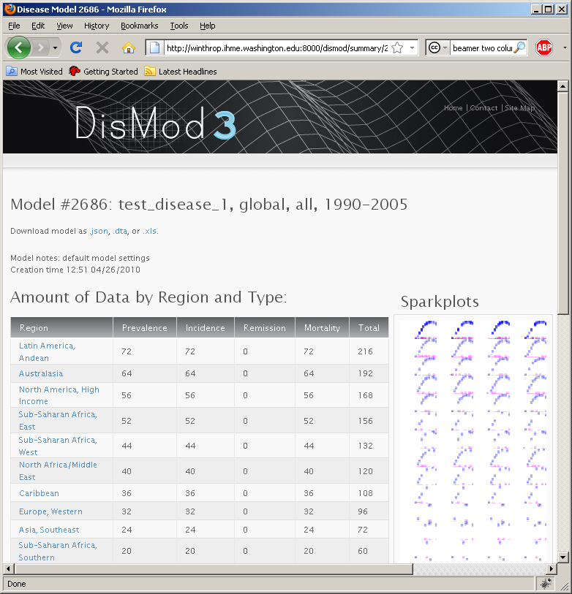
DisMod III

Slide 30
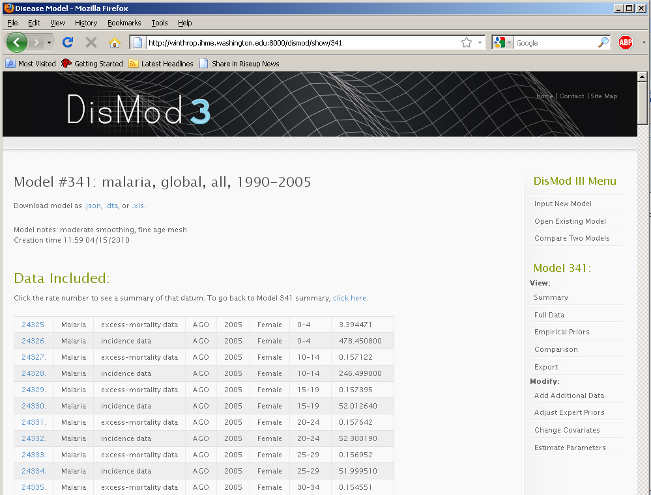
DisMod Disease View

Slide 31
DisMod Expert Priors
Smoothing
Heterogeneity
Level bounds / values
Increasing, decreasing, unimodal

Slide 32
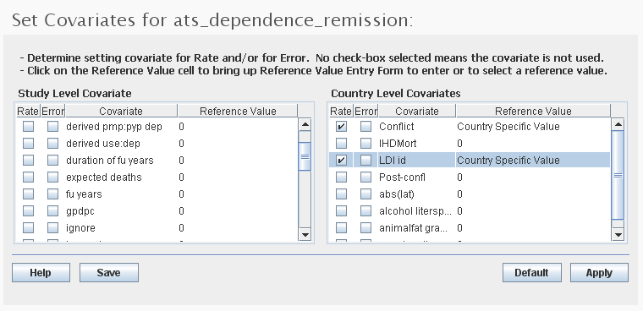
DisMod Covariates

Slide 33
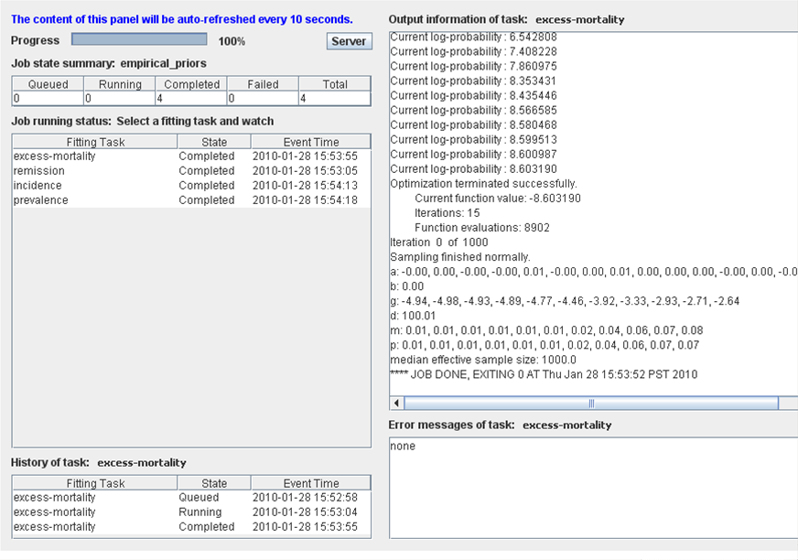
DisMod Status Panel

Slide 34
Validation by Simulation Study
Generate gold-standard data, 8400 rates with consistent incidence, prevalence, remission, excess-mortality
Sample small portion of data, with noisy data generation model
Run DisMod III on the sample
 | Gold Standard |  | Hold-out Cross-validation
 | Median Error |  | Median Error |  | Uncertainty Interval Coverage
 | Absolute (per 10,000) | Relative | Absolute (per 10,000) | Relative
Incidence | 7.5 | 11 % | 8.1 | 3.2 % | 94 %
Prevalence | 22 | 16 % | 77 | 3.2 % | 73 %
Remission | 0.13 |  | 0.12
Excess Mortality | 7.5 | 4.4 % | 13 | 2.9 % | 98 %
Duration | 2.5 years | 15%

Slide 35
DisMod Example:
Guillain-Barré syndrome (GBS)
Autoimmune disorder affecting the peripheral nervous system following an infectious disease
Characterised by an ascending paralysis, spreading from legs to upper limbs and face

Slide 36
GBS data inputs
Incidence
Remission
Mortality set to 0 after adjusting incidence by pooled case-fatality assuming that disease specific mortality risk is early in disease with no further excess mortality thereafter
Notes:
http://winthrop.ihme.washington.edu/dismod/show/tile_1147_guillain-barre_syndrome+all+all+all+all.png

Slide 37
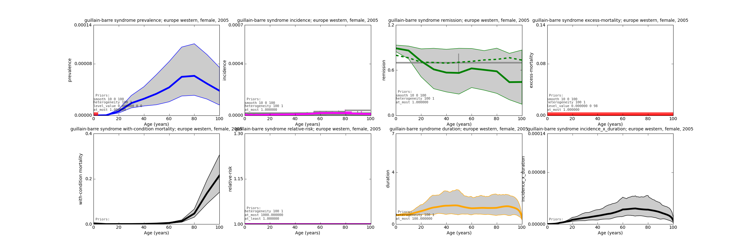
2005 GBS model posteriors
Notes:
http://winthrop.ihme.washington.edu/dismod/show/tile_1147_guillain-barre_syndrome+all+europe_western+2005+female.png

Slide 38
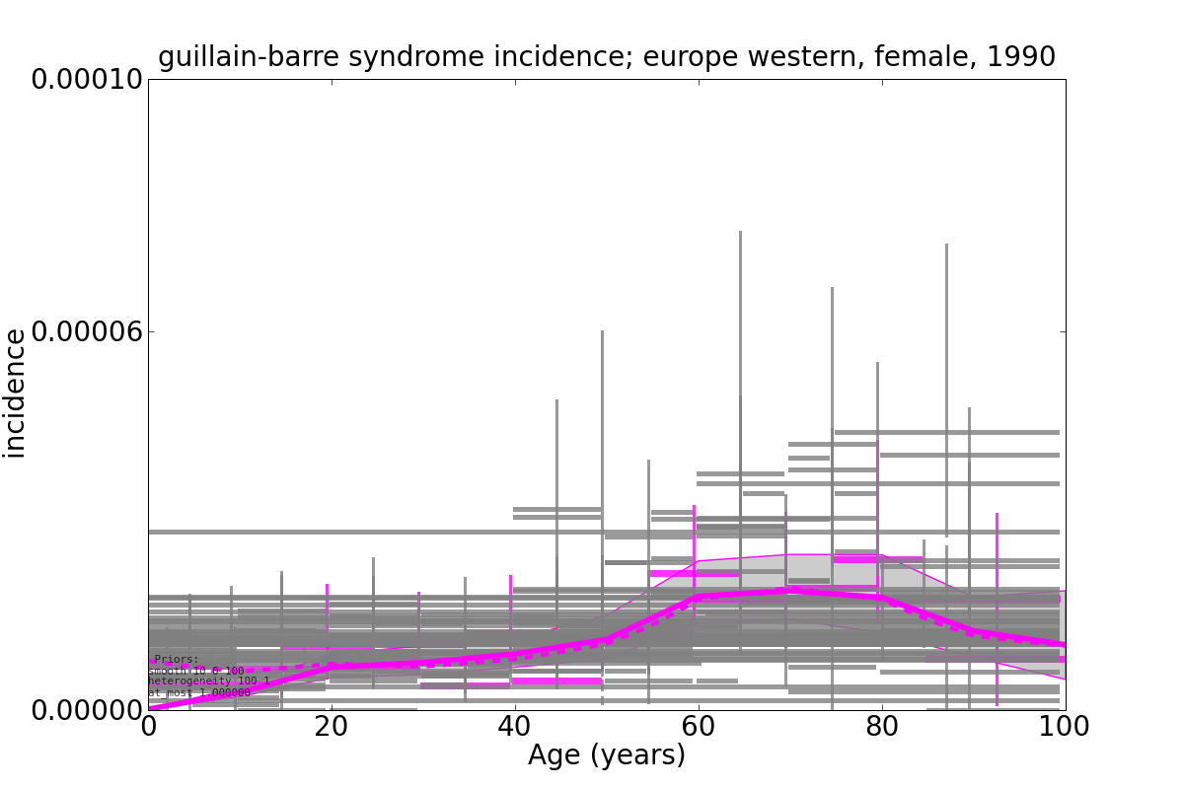
GBS Incidence in females, 1990

Slide 39
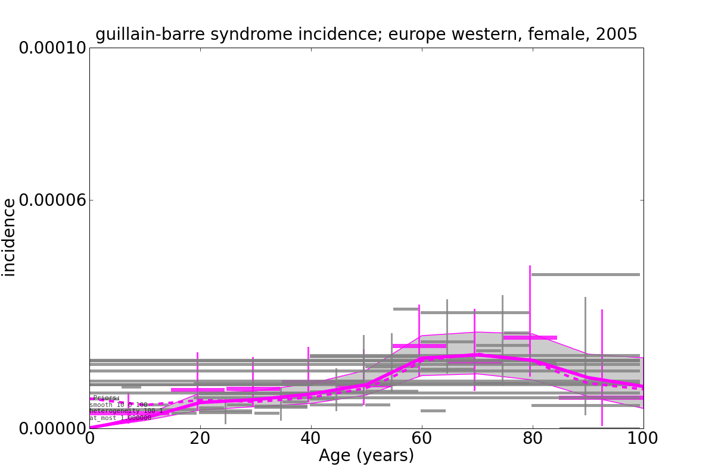
GBS Incidence in females, 2005

Slide 40
Conclusion and Lessons Learned
Systematic literature review quality are crucial
  Precious raw material that DisMod runs on…
  …or GIGO?
Expert knowledge from Doctors and Epidemiologists is crucial
  Bayesian Priors will affect output, especially for parameters without much data
  Covariate selection will affect output, especially in regions without much data

Slide 41
Acknowledgements
DisMod Visionaries
  Chris Murray
  Moshen Naghavi
  Theo Vos
  Rafael Lozano
  Steve Lim
  Colin Mathers
  Majid Ezzati
  Jan Barendregt
  Rebecca Cooley
DisMod Software Engineer
  Jiaji Du
DisMod Early Adopters
  Jed Balore
  Allyne Dellosantos
  Samath Dharmaratne
  Merhdad Forouzan
  Maya Mascarenhas
  Nate Nair
  Rosanna Norman
  Farshad Purmalek
  Saied Shahraz
  Gretchen Stevens

